Slide 1
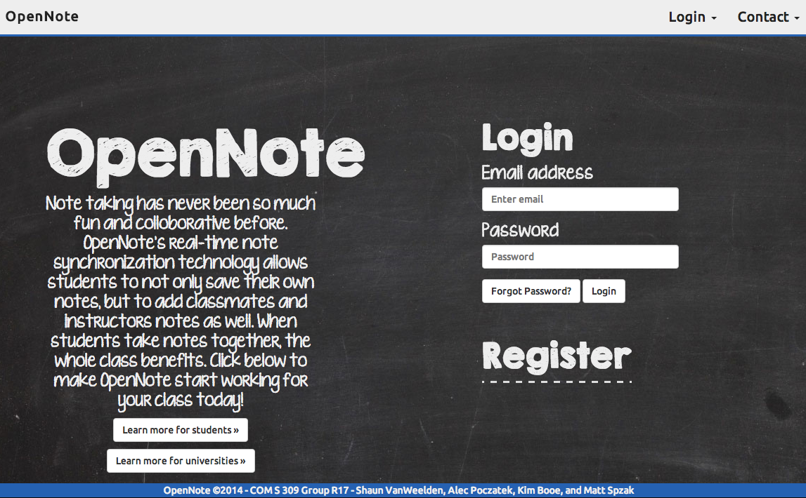
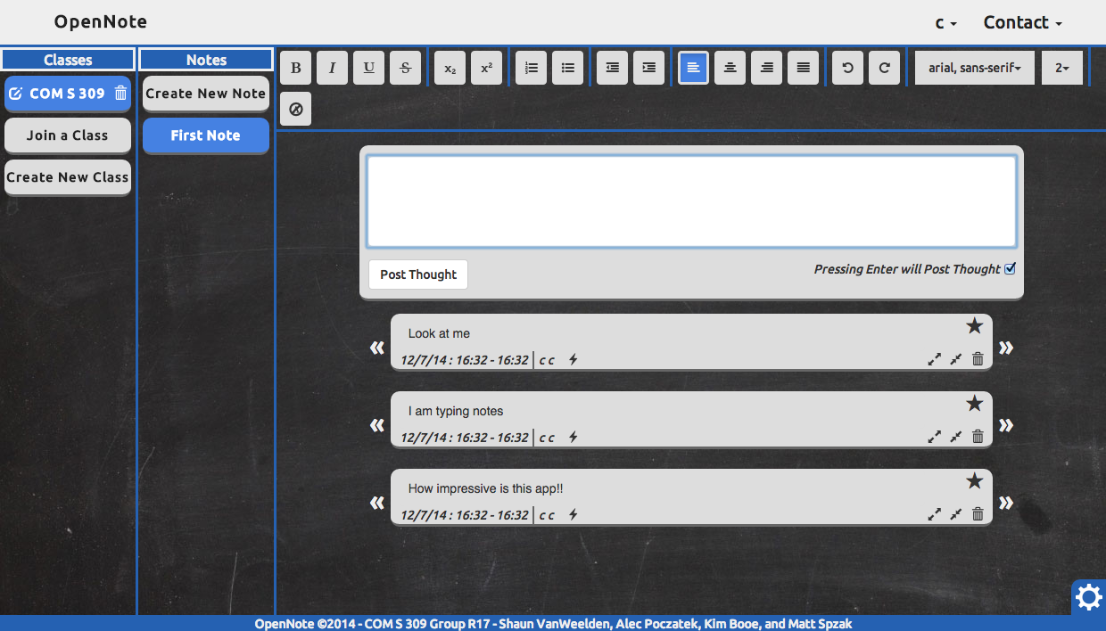
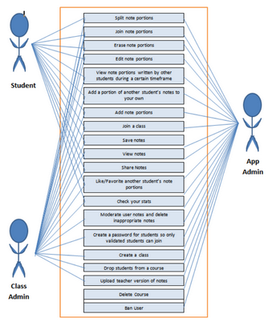
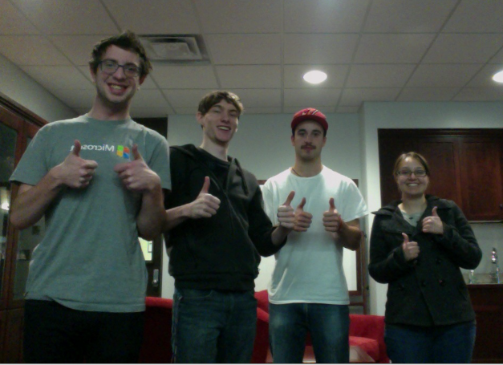
OpenNote
Created By:
Kim Booe
Shaun Van Weelden
Matthew Szpak
Alec Poczatek
COM S 309 Fall 2014
Note taking has never been so much fun and collaborative before. OpenNote’s Real-time synchronization technology allows students to not only save their own notes, but to add classmates and instructors notes as well. When students take notes together the whole class benefits.
User-Interfaces
The user interface for the student and class creator are one in the same. The only difference is that the class creator has more power within the app. They can manage their classes by removing users or changing the class specs/information.
Actors
OpenNote consists of three different types of actors:
Student – Every user that uses the app to take notes is considered a student. They are the users that use the app to keep their ntoes organized and work together collaboratively with other students to create the best possible notes.
Class Creator – The user that has originally created the class. This user is able to remove users from their class, as well as delete the class they created if they like.
Use-Cases
The app is geared towards the student. The student has the ability to take notes, and share them collaboratively with other classmates. Once a note is created, the student can compare their notes with other classmates in order to fill in a spot they missed, or to insert a better note. The student can also split their notes into different portions, edit their note portions, delete their note portions, or combine their note portions. As a class creator, you have the ability to remove inappropriate users from your class, or to change the information pertaining to the class
Design Decisions
Above is an image of the login screen. We decided to use a chalk-type font to be cohesive with our note taking theme. It is a very simple user interface, however uses modern transitions from one screen to another.
Document Screen
Login Screen
Team Info
Coming into this project, none of our group members knew too much about eachother. But having spent a whole semester together we have learned a lot, and grown to become very good friends. We learned a great deal about the process involved in making an app, as well as how important communication is. It isn’t always opportune to meet for everyone so it is extremely important to split up work and collaborate often.
Insert team picture
Team R17

